Slide 1
EE2211 Tutorial 7
(remember to sign your attendance on the sheet of paper)

Slide 2
Lecture recap

Slide 3
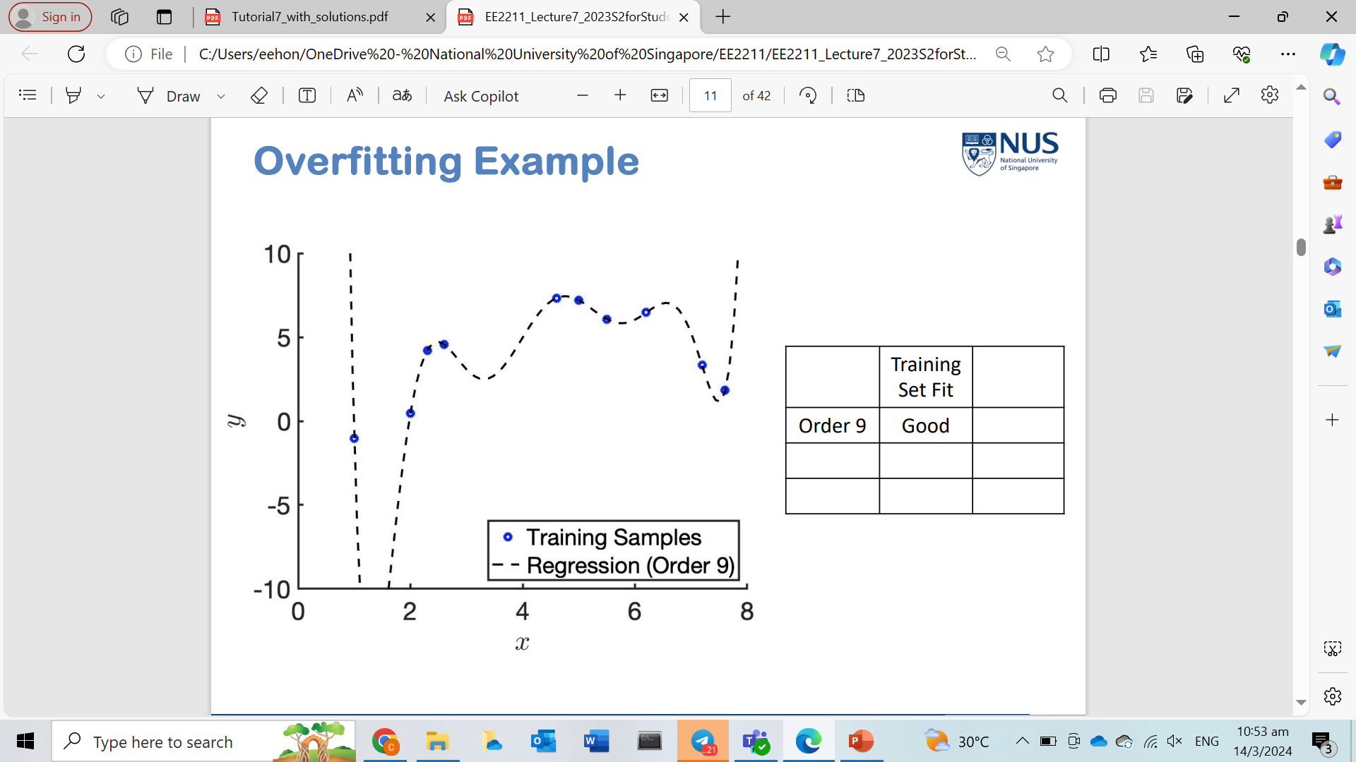
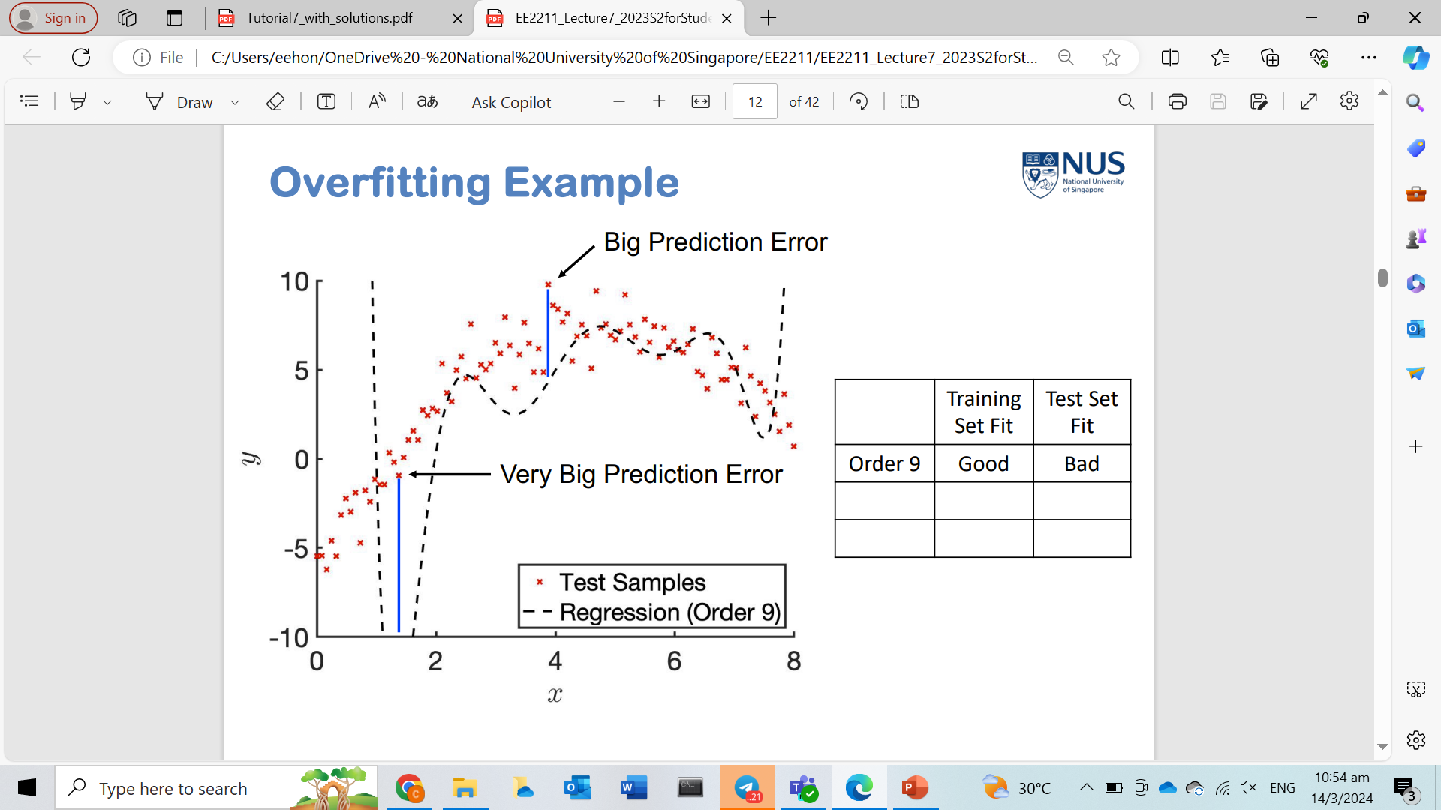
Overfitting
Training
Testing

Slide 4
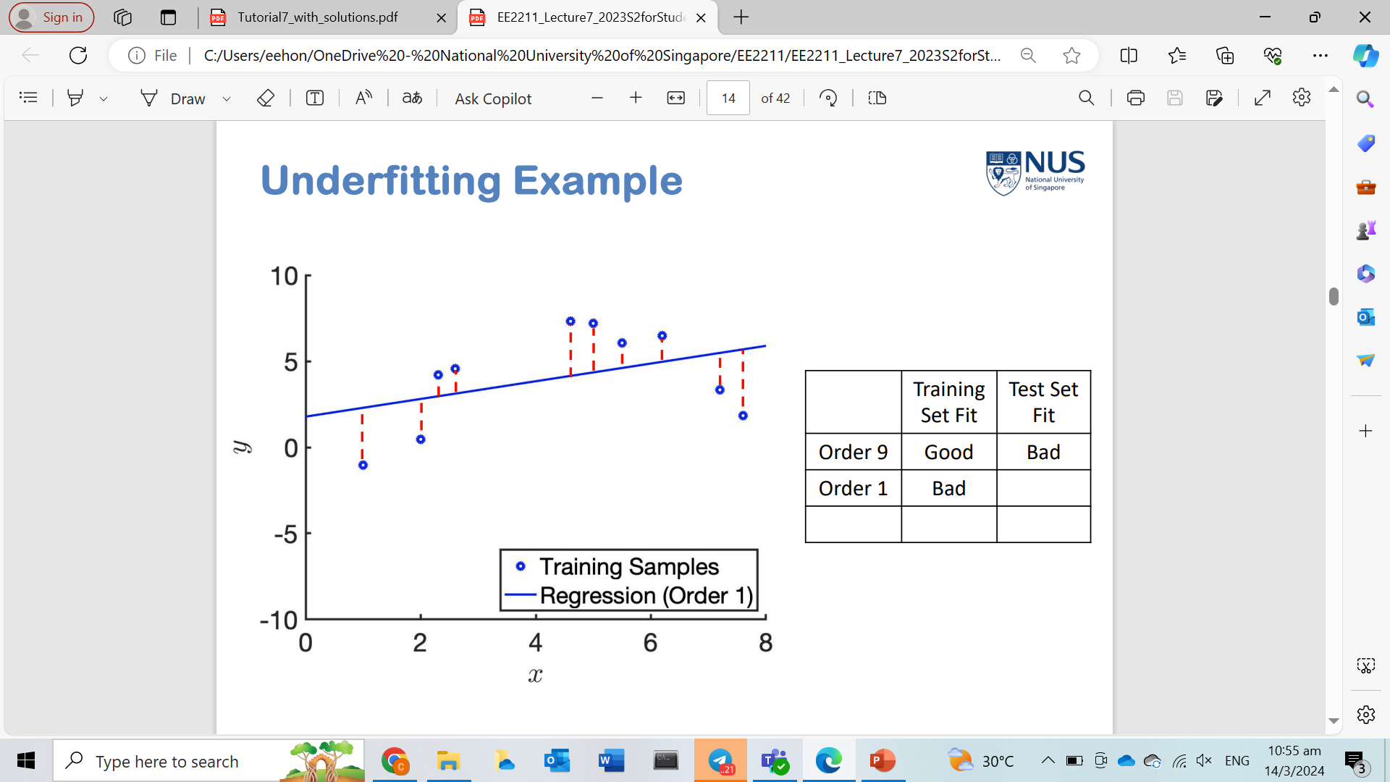
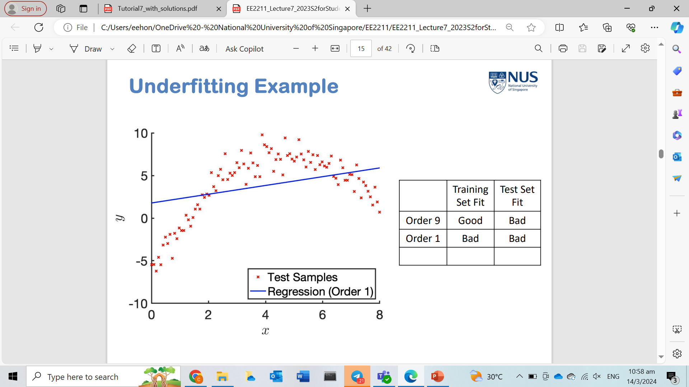
Underfitting
Training
Testing

Slide 5
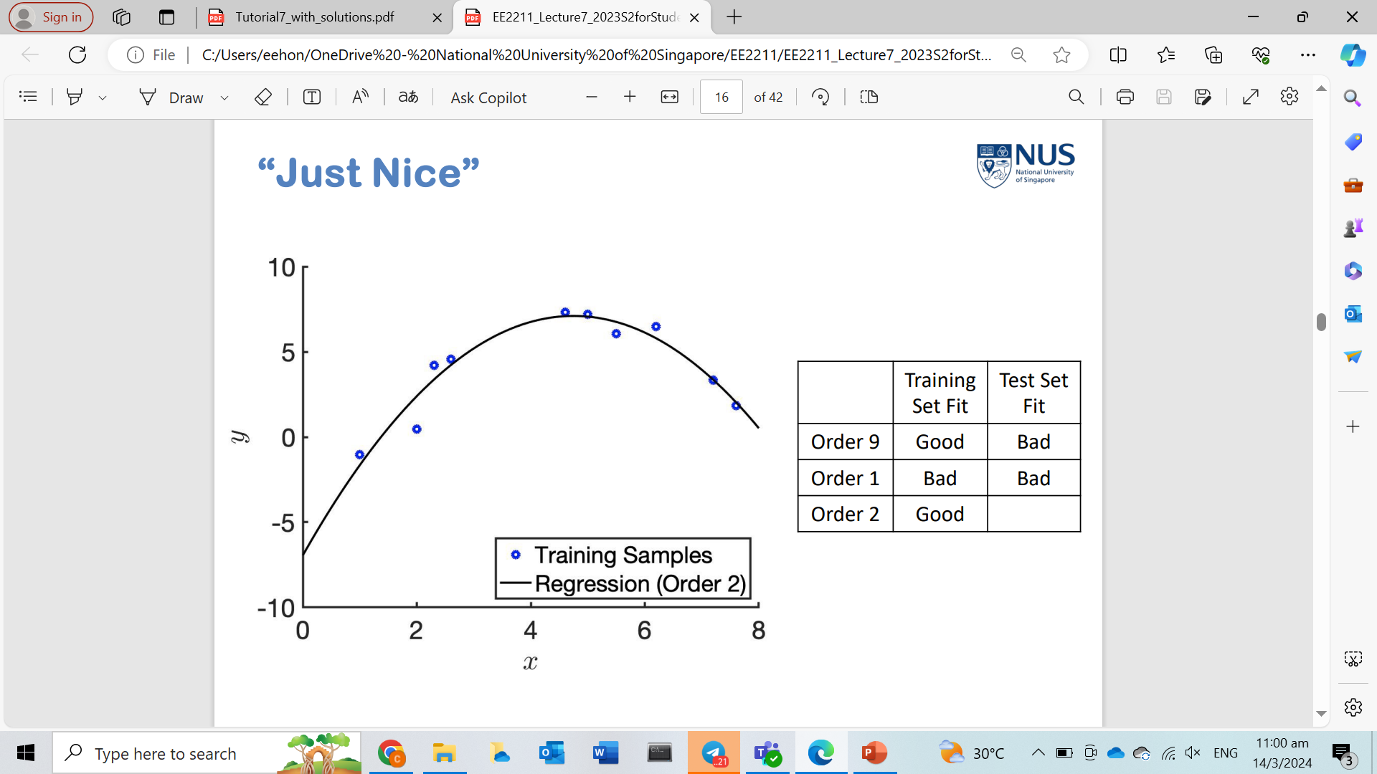
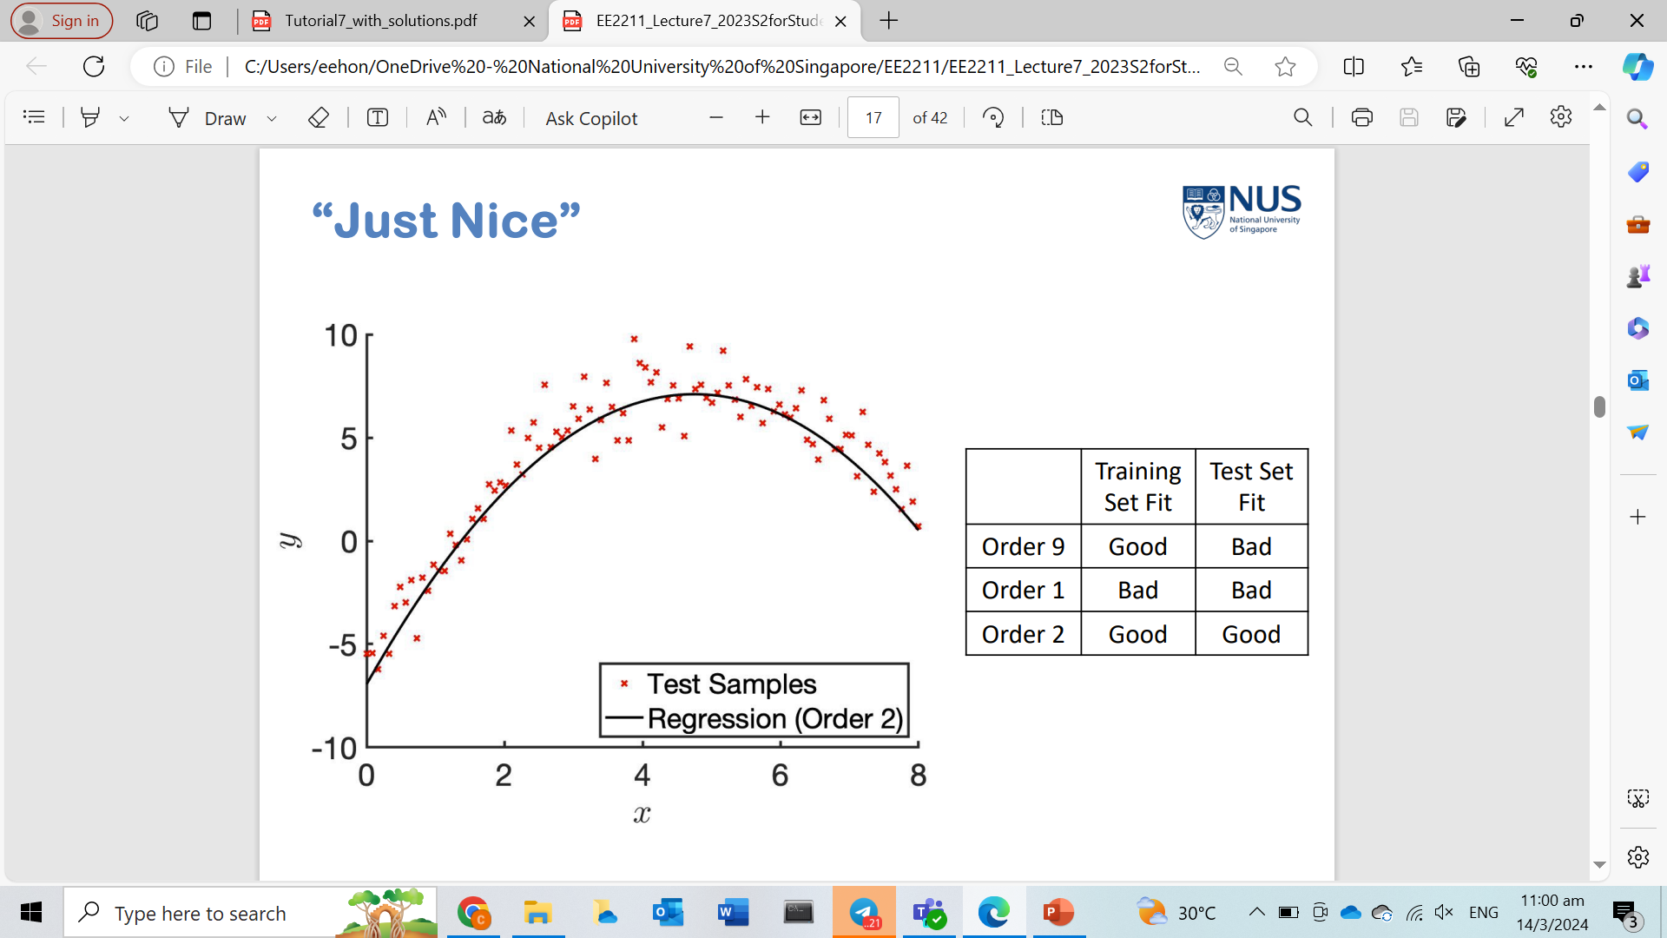
Perfect fitting
Training
Testing

Slide 6
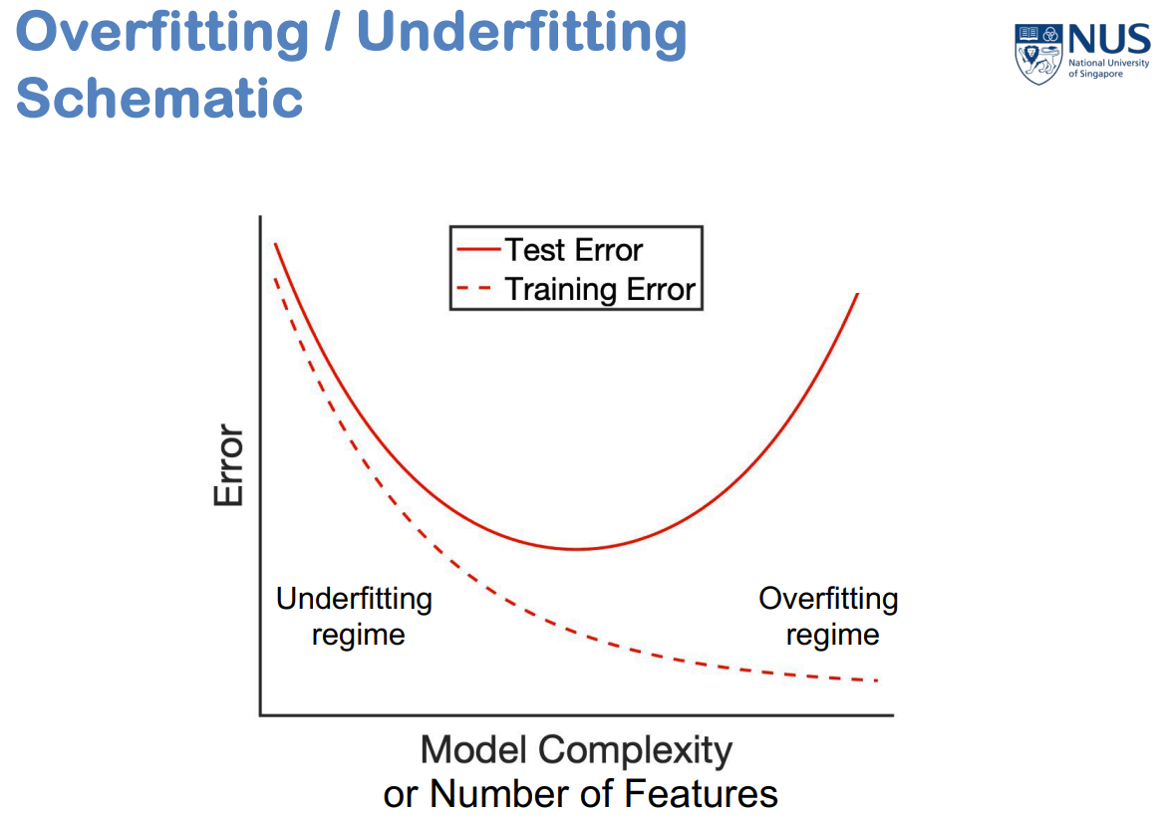
Fitting vs model complexity

Slide 7
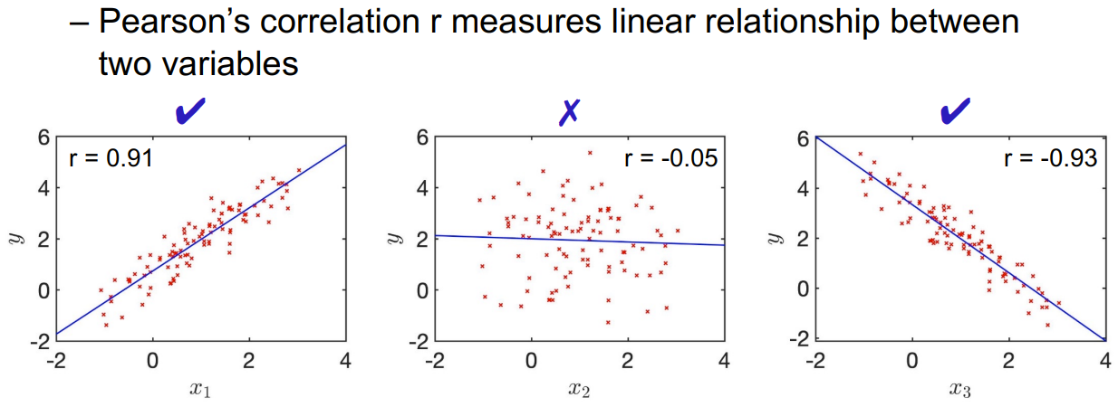
Pearson’s r

Slide 8
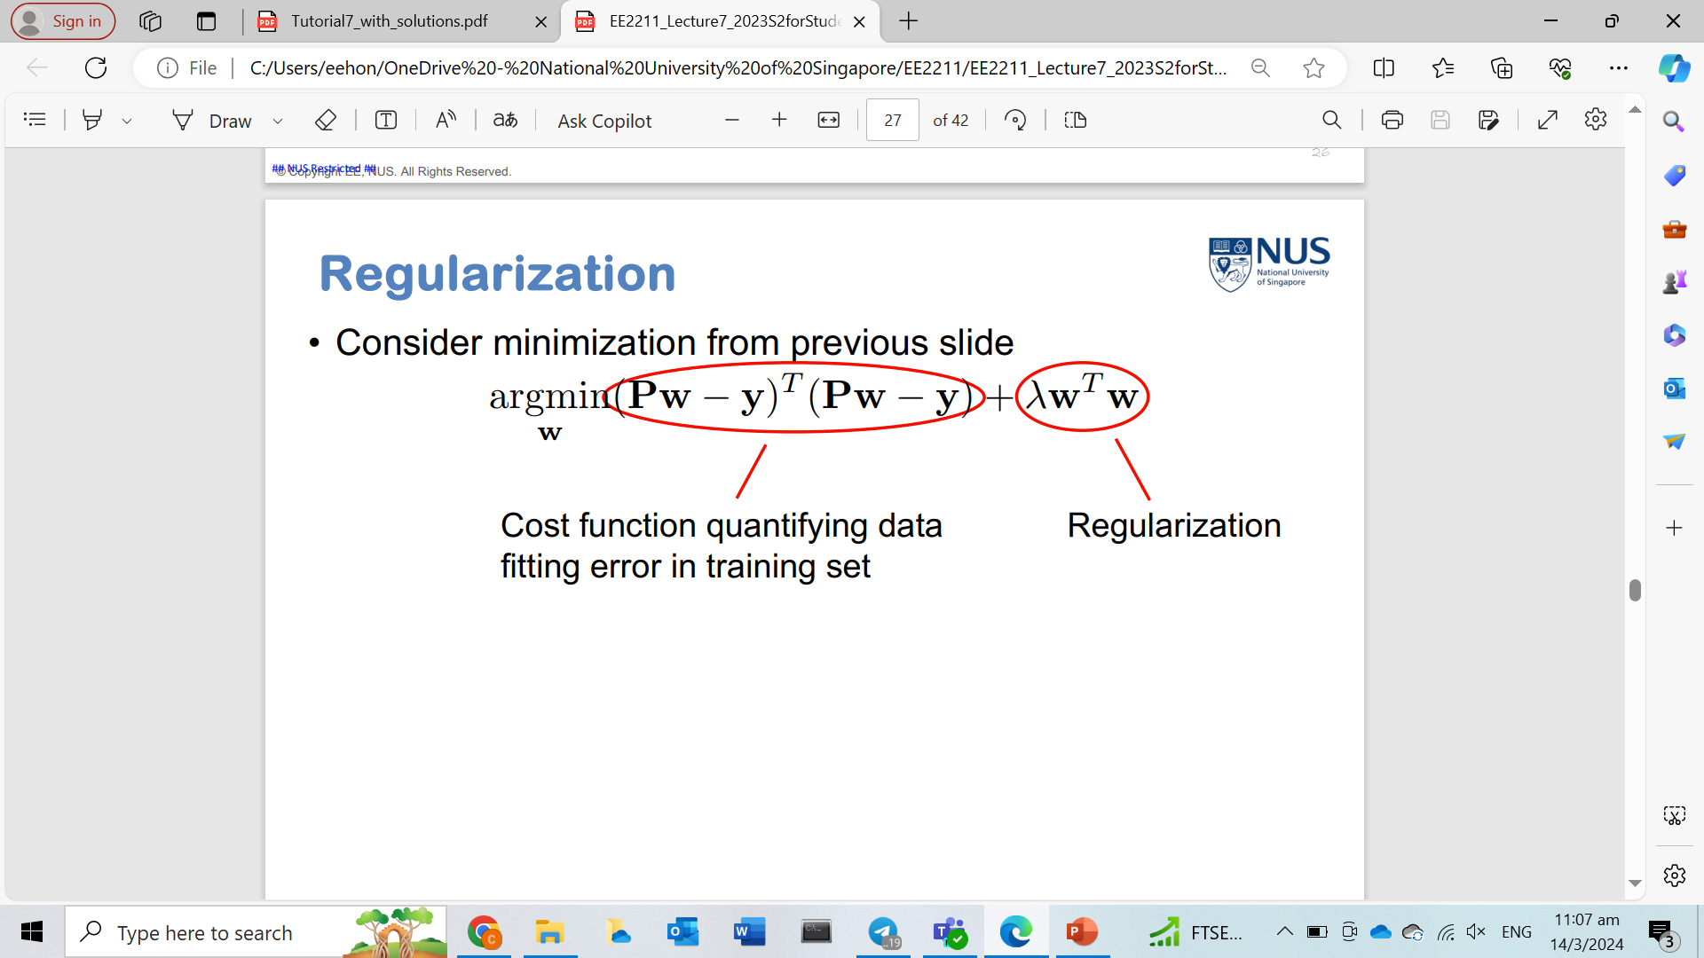
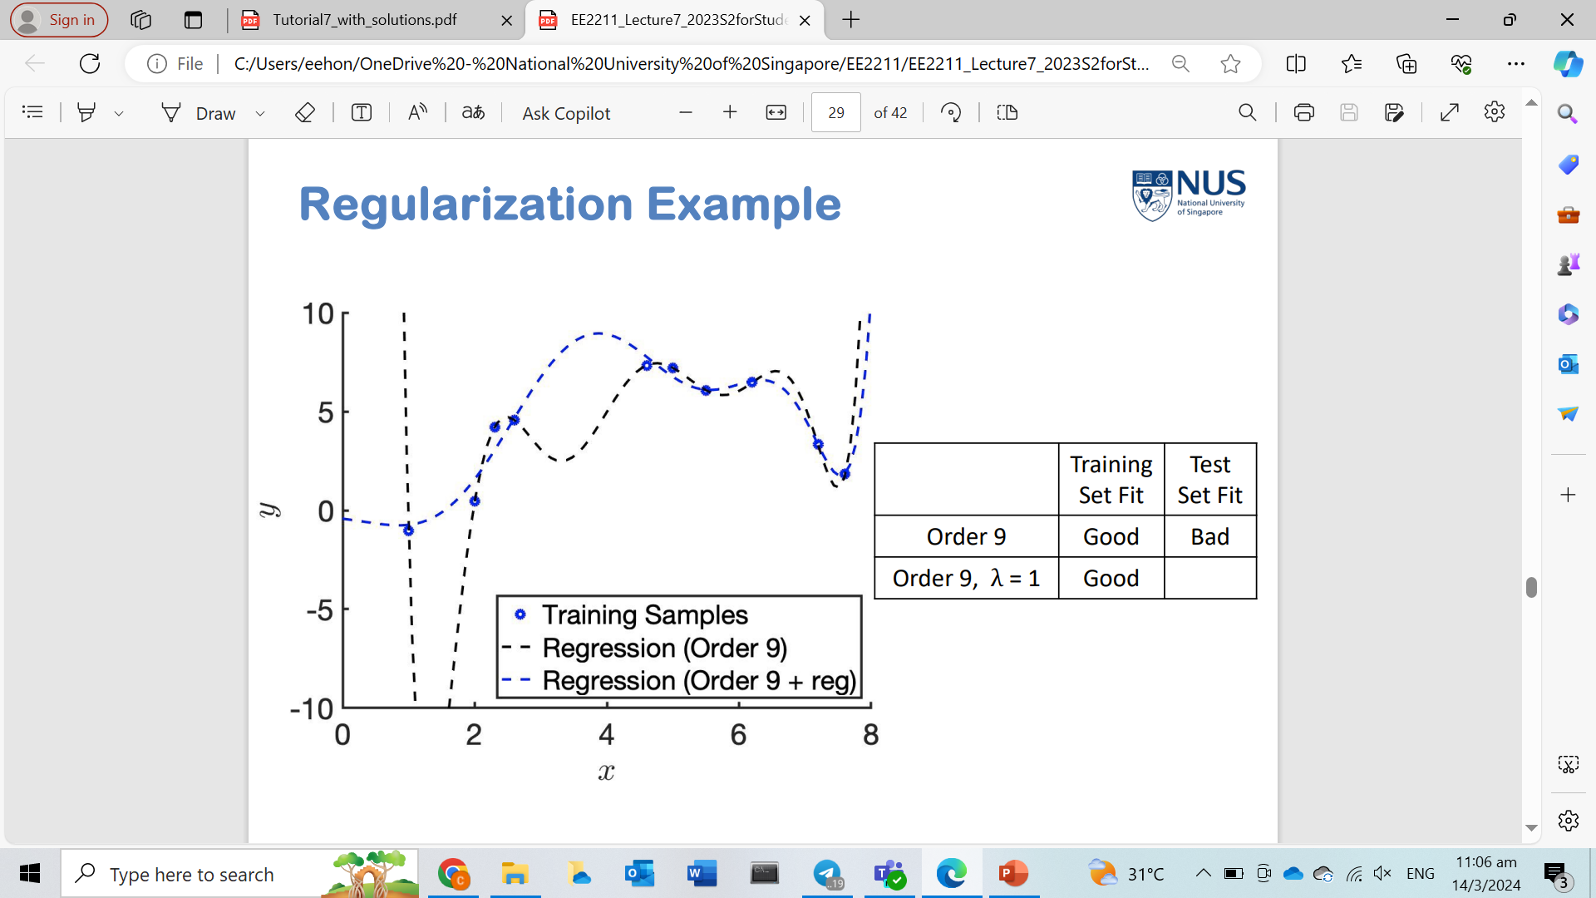
regularization

Slide 9
Tutorial 7

Slide 10
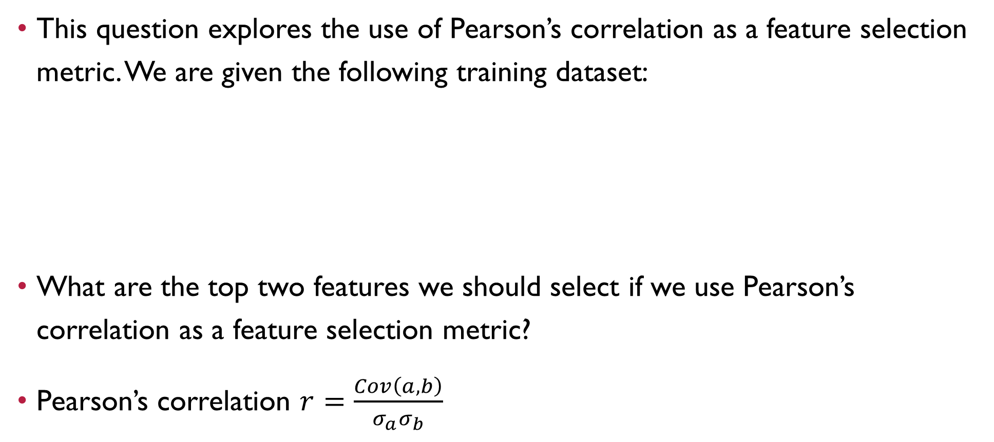
Question 1
This question explores the use of Pearson’s correlation as a feature selection metric. We are given the following training dataset:
What are the top two features we should select if we use Pearson’s correlation as a feature selection metric?
Pearson’s correlation $r=\frac{Cov\left(a,b\right)}{σ_{a}σ_{b}}$
 | Datapoint 1 | Datapoint 2 | Datapoint 3 | Datapoint 4 | Datapoint 5
Feature 1 | 0.3510 | 2.1812 | 0.2415 | -0.1096 | 0.1544
Feature 2 | 1.1796 | 2.1068 | 1.7753 | 1.2747 | 2.0851
Feature 3 | -0.9852 | 1.3766 | -1.3244 | -0.6316 | -0.8320
Target y | 0.2758 | 1.4392 | -0.4611 | 0.6154 | 1.0006

Slide 11
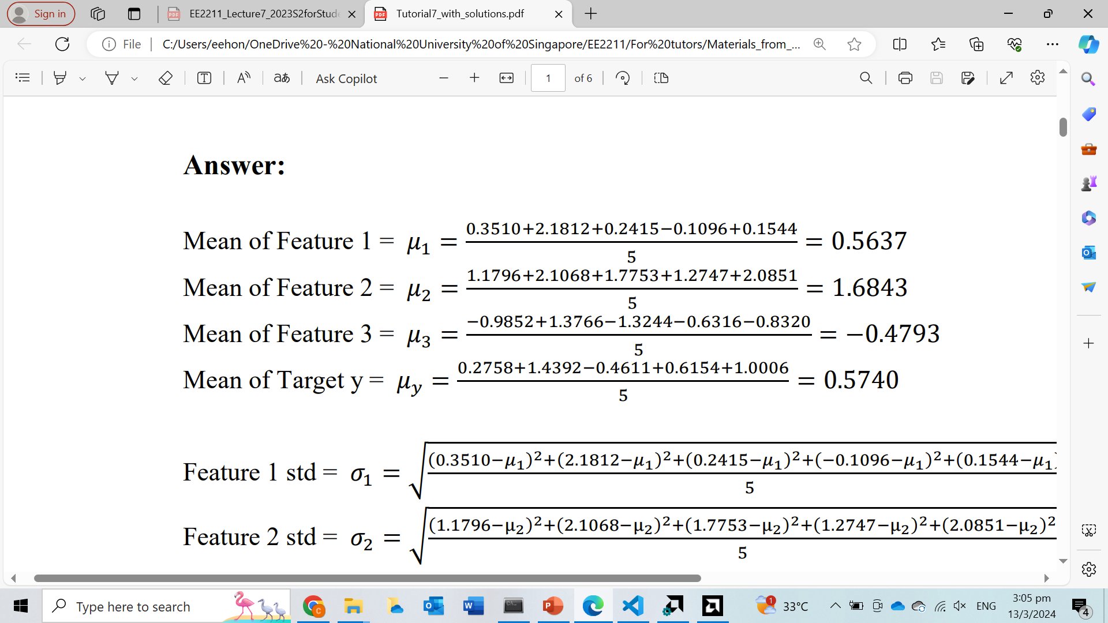
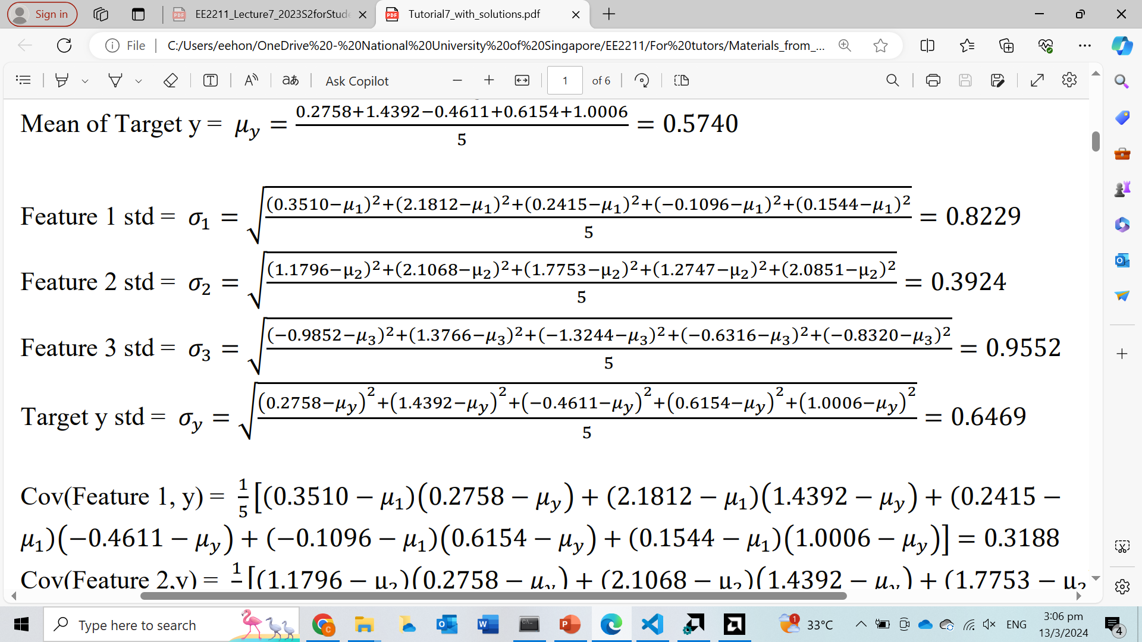
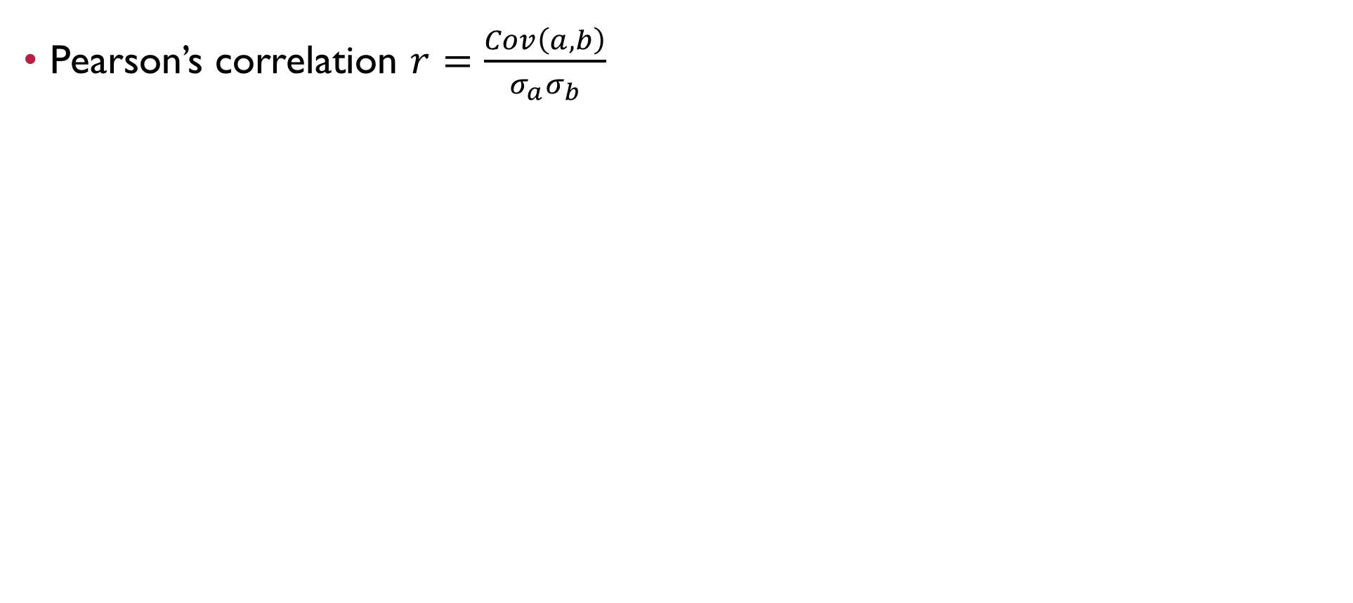
Question 1
Pearson’s correlation $r=\frac{Cov\left(a,b\right)}{σ_{a}σ_{b}}$

Slide 12
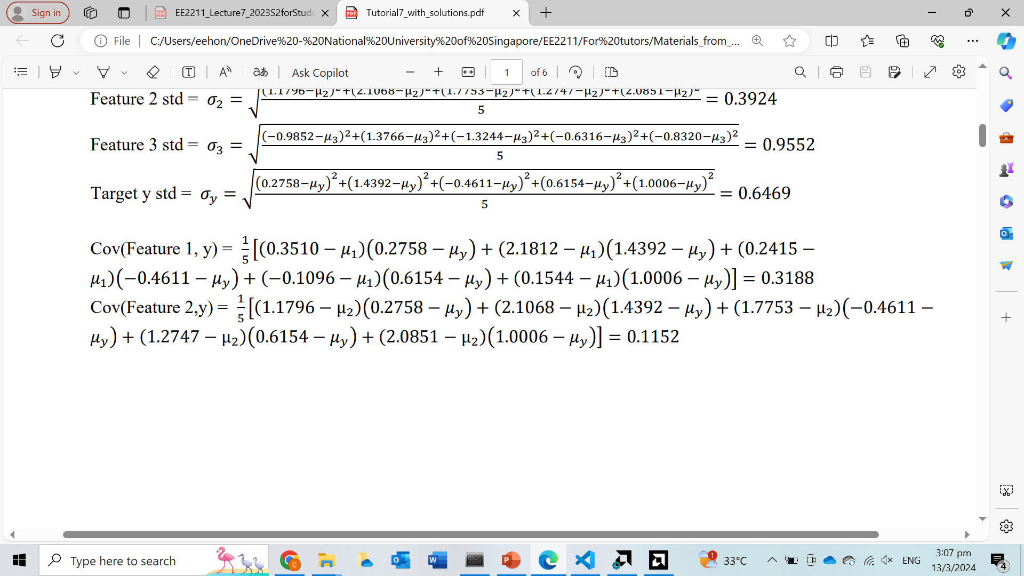
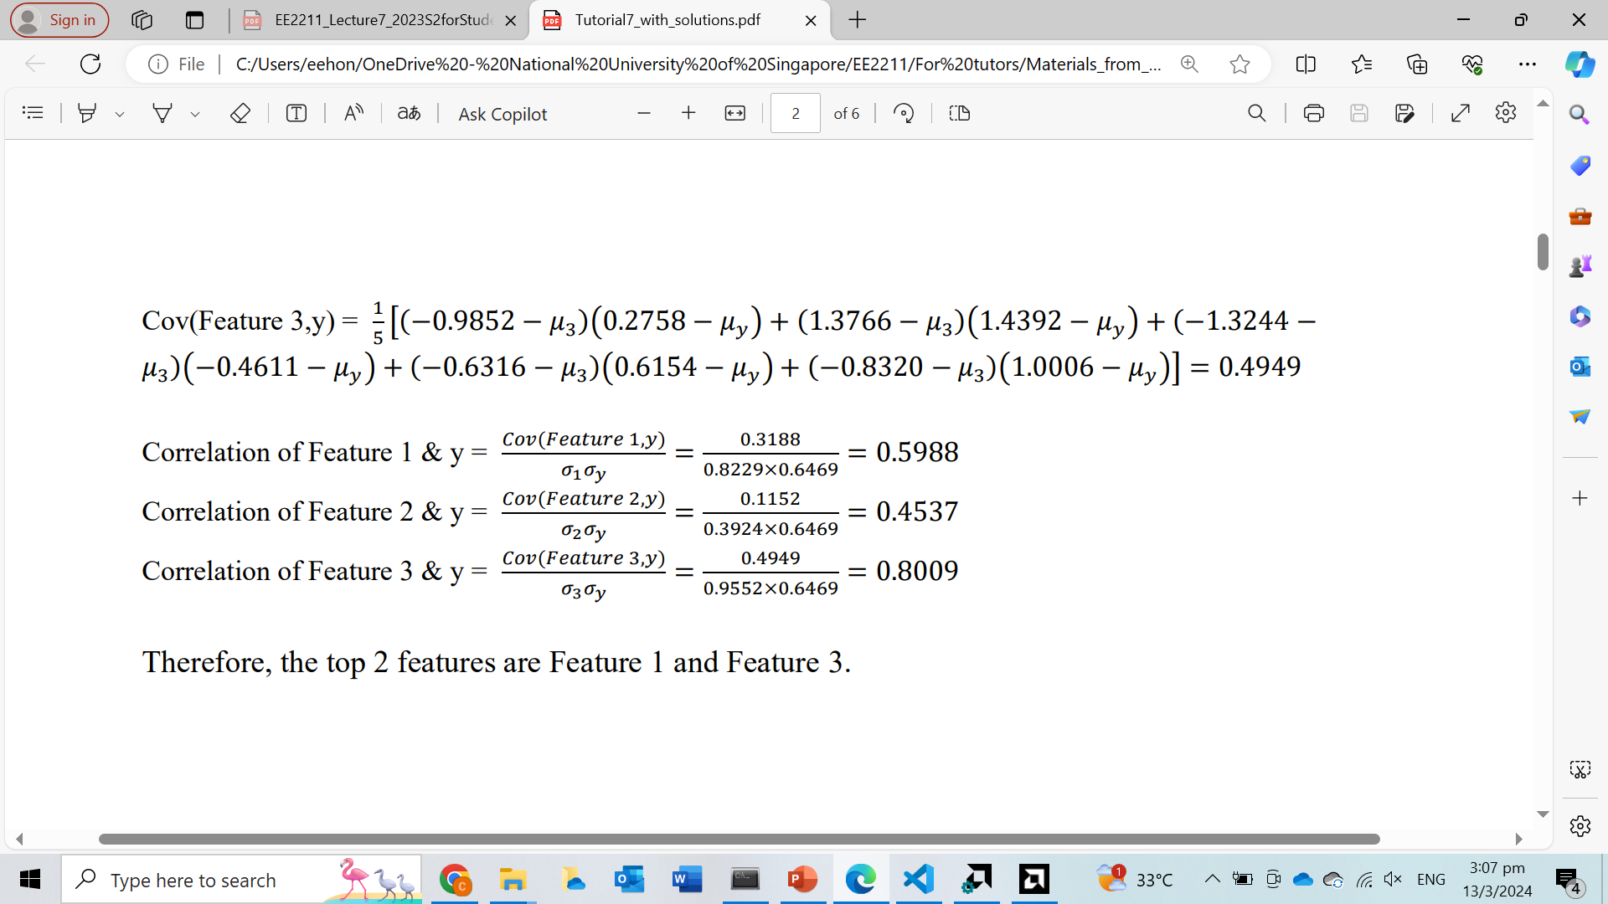
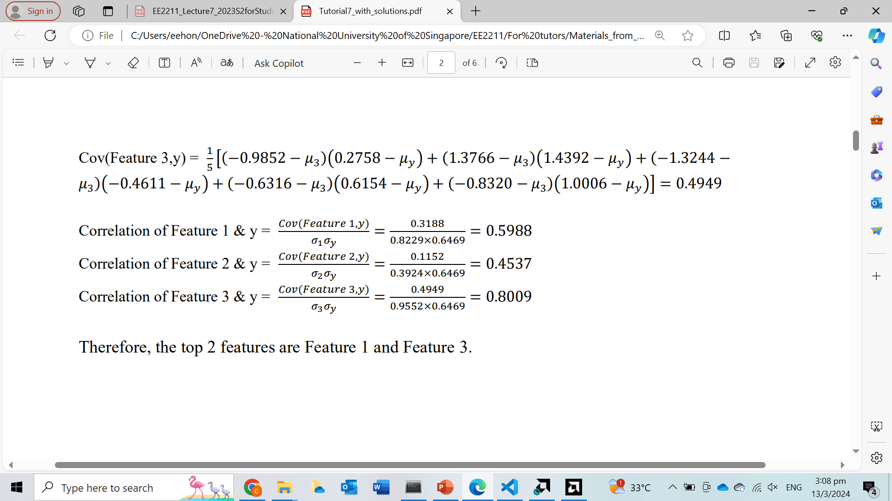
Question 1
Pearson’s correlation $r=\frac{Cov\left(a,b\right)}{σ_{a}σ_{b}}$

Slide 13
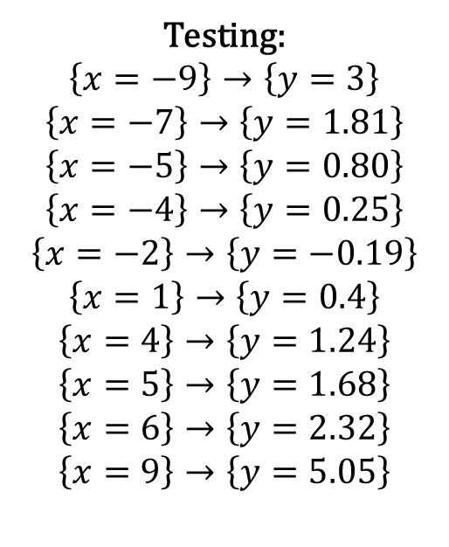
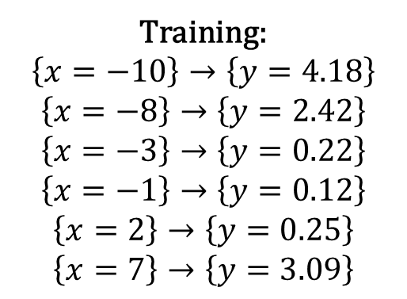
Question 2
This question further explores linear regression and ridge regression. The following data pairs are used for training and testing:
Training:
$$\left\{x=−10\right\}→\left\{y=4.18\right\}$$
$$\left\{x=−8\right\}→\left\{y=2.42\right\}$$
$$\left\{x=−3\right\}→\left\{y=0.22\right\}$$
$$\left\{x=−1\right\}→\left\{y=0.12\right\}$$
$$\left\{x=2\right\}→\left\{y=0.25\right\}$$
$$\left\{x=7\right\}→\left\{y=3.09\right\}$$
Testing:
$$\left\{x=−9\right\}→\left\{y=3\right\}$$
$$\left\{x=−7\right\}→\left\{y=1.81\right\}$$
$$\left\{x=−5\right\}→\left\{y=0.80\right\}$$
$$\left\{x=−4\right\}→\left\{y=0.25\right\}$$
$$\left\{x=−2\right\}→\left\{y=−0.19\right\}$$
$$\left\{x=1\right\}→\left\{y=0.4\right\}$$
$$\left\{x=4\right\}→\left\{y=1.24\right\}$$
$$\left\{x=5\right\}→\left\{y=1.68\right\}$$
$$\left\{x=6\right\}→\left\{y=2.32\right\}$$
$$\left\{x=9\right\}→\left\{y=5.05\right\}$$

Slide 14
Question 2
This question further explores linear regression and ridge regression. The following data pairs are used for training and testing:
Use the polynomial model from orders 1 to 6 to train and test the data without regularization. Plot the Mean Squared Errors (MSE) over orders from 1 to 6 for both the training and the test sets. Which model order provides the best MSE in the training and test sets? Why?

Slide 15
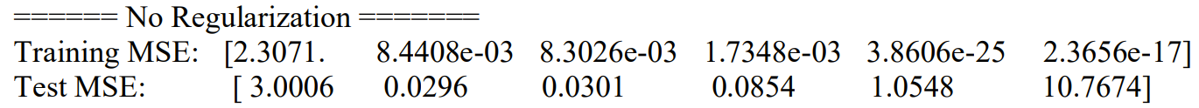
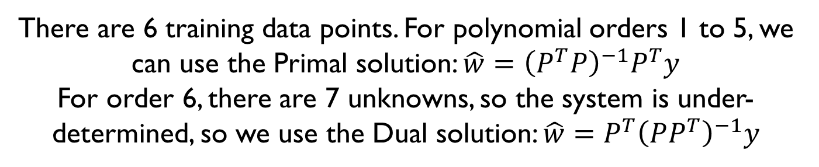
Question 2
Use the polynomial model from orders 1 to 6 to train and test the data without regularization. Plot the Mean Squared Errors (MSE) over orders from 1 to 6 for both the training and the test sets. Which model order provides the best MSE in the training and test sets? Why?
There are 6 training data points. For polynomial orders 1 to 5, we can use the Primal solution: $\hat{w}={\left(P^{T}P\right)}^{−1}P^{T}y$
For order 6, there are 7 unknowns, so the system is under-determined, so we use the Dual solution: $\hat{w}={P^{T}\left(PP^{T}\right)}^{−1}y$

Slide 16
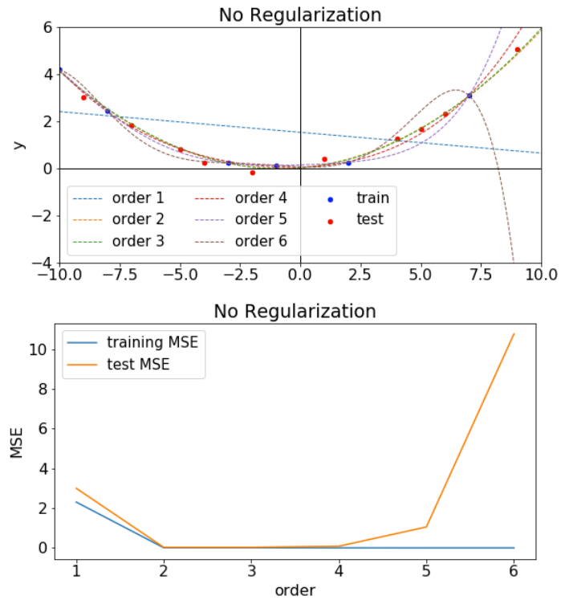
Question 2
Observe that the estimated polynomial curves for orders 5 and 6 pass through the training samples exactly. This results in training MSE of virtually 0, but high test MSE => overfitting
Note that even though the true underlying data came from a quadratic model (order = 2), estimated polynomial curves for orders 2, 3 and 4 have relatively low training and test MSE
Polynomial curve of order 1 (linear curves) have high training and test MSE => underfitting

Slide 17
Question 2
This question further explores linear regression and ridge regression. The following data pairs are used for training and testing:
Use regularization (ridge regression) λ=1 for all orders and repeat the same analyses. Compare the plots of (a) and (b). What do you see?

Slide 18
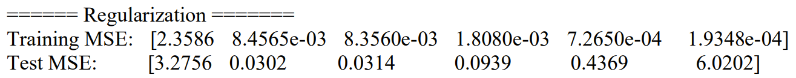

Question 2
Use regularization (ridge regression) λ=1 for all orders and repeat the same analyses. Compare the plots of (a) and (b). What do you see?
With regularization, we can simply use the primal solution even for order 6: $\hat{w}={\left(P^{T}P+λI\right)}^{−1}P^{T}y$

Slide 19
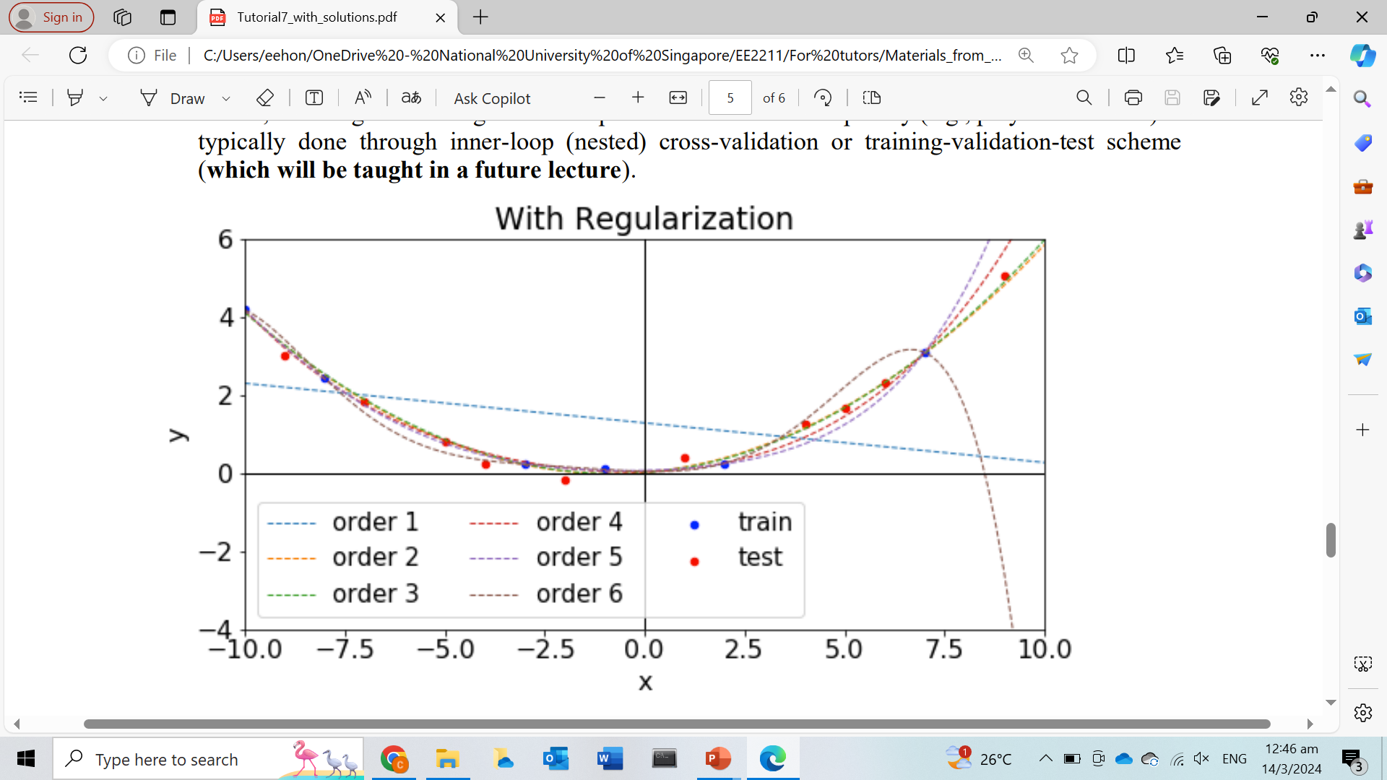
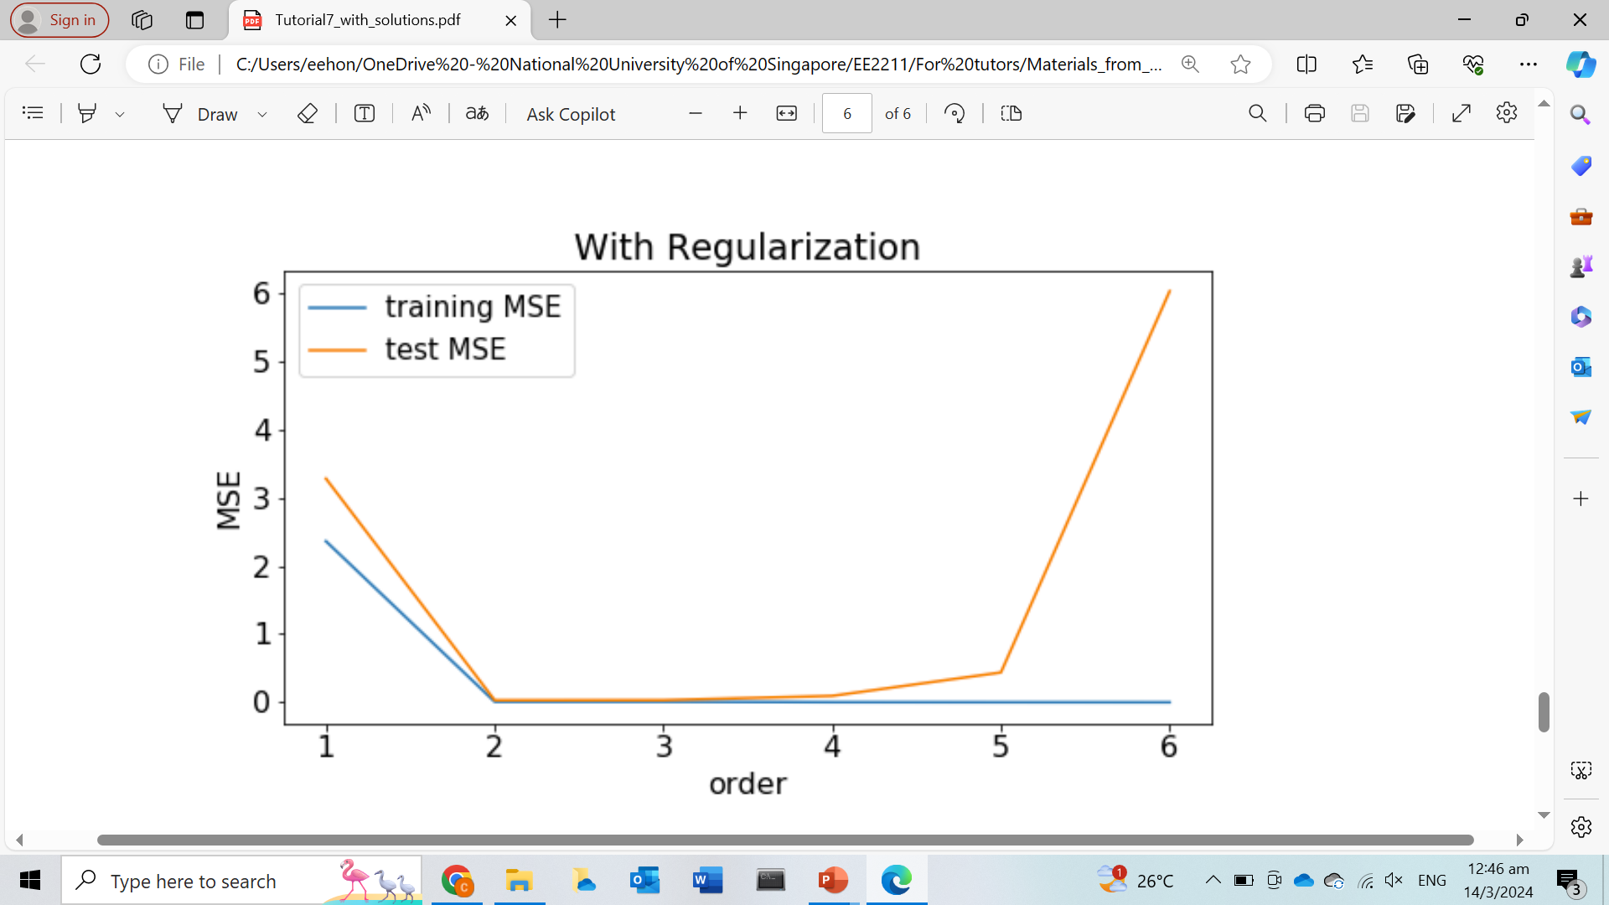
Question 2
With the regularization, none of the polynomial curves passes through the training samples exactly. In the case of orders 5 and 6, test MSE dropped from 1.0548 (order 5) and 10.7674 (order 6) to 0.4369 (order 5) and 6.0202 (order 6) after regularization was added. Thus, the regularization reduces the overfitting
On the other hand, the regularization did not help orders 1 to 4. Observe that the test MSE actually went up. In this case, the regularization was overly strong, which ended up hurting these orders

Slide 20


Questions?
Feel free to come up to me if you have any questions about anything!
If you are shy, you can use the anonymous form to leave questions & feedback about the tutorial.
You can also reach out to me on our Telegram group or PM me at @eehongchan
Anonymous feedback
Telegram
https://forms.gle/c9QU94YcWjR3EZFk9

